Slide 1
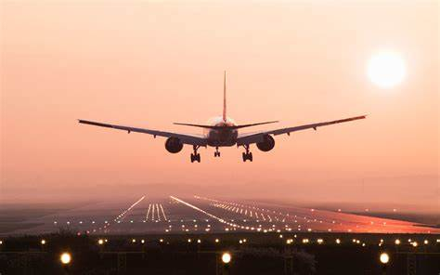
FLIGHT PRICE PREDICTION PROJECT
Submitted By:
Lakshmi Rajendra Thute

Slide 2
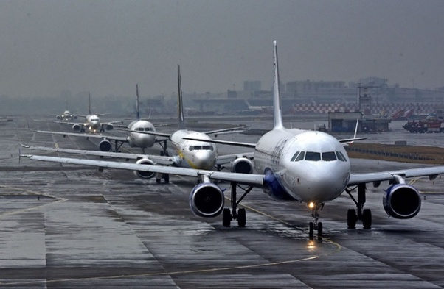
INTRODUCTION
Anyone who has booked a flight ticket knows how unexpectedly the prices vary. The cheapest available ticket on a given flight gets more and less expensive over time. This usually happens as an attempt to maximize revenue based on - 1. Time of purchase patterns (making sure last-minute purchases are expensive) 2. Keeping the flight as full as they want it (raising prices on a flight which is filling up in order to reduce sales and hold back inventory for those expensive last-minute expensive purchases) So, you have to work on a project where you collect data of flight fares with other features and work to make a model to predict fares of flights.

Slide 3
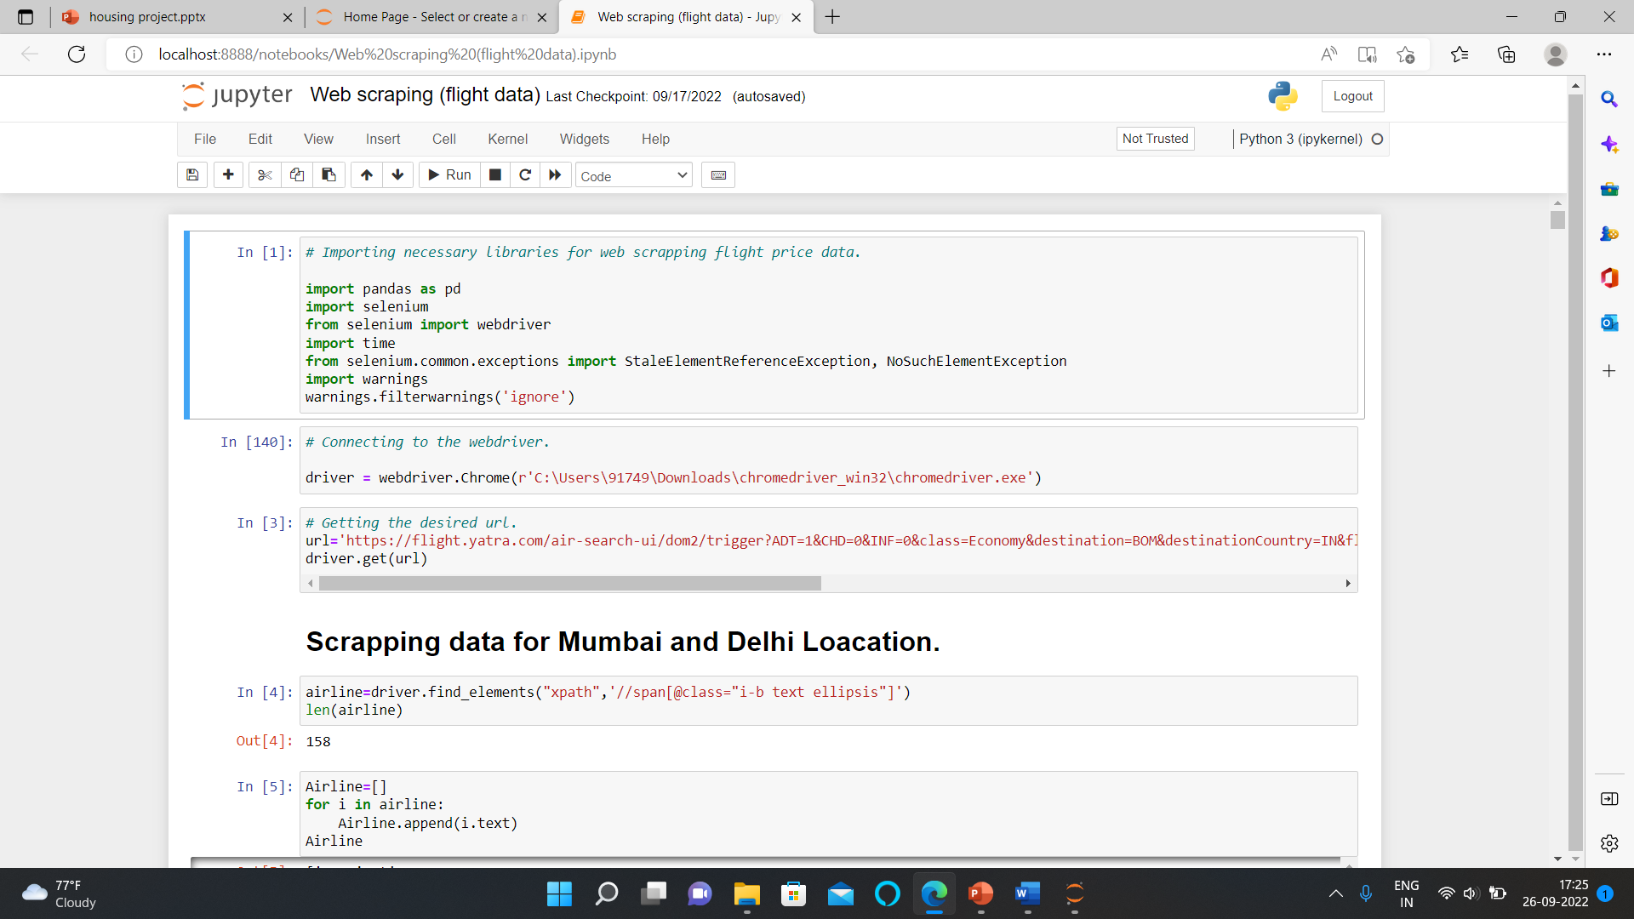
ANALYTICAL PROBLEM FRAMING
Firstly, I scrapped the flight data including airline name, date of journey, source, destination, route, departure time, arrival time, duration, total stops and the target variable price using Selenium

Slide 4
DATA COLLECTION AND PRE-PROCESSING
Data Collection: I got the dataset in CSV format and I read the data in Jupyter Notebook using pandas data frame.
Shape of data: The dataset contains total 1592 rows and 9 columns.
Data Summary: The dataset contains 1 integer and 8 object data type columns.
Missing Values: The dataset contains missing values and we treat them with mode imputation.

Slide 5
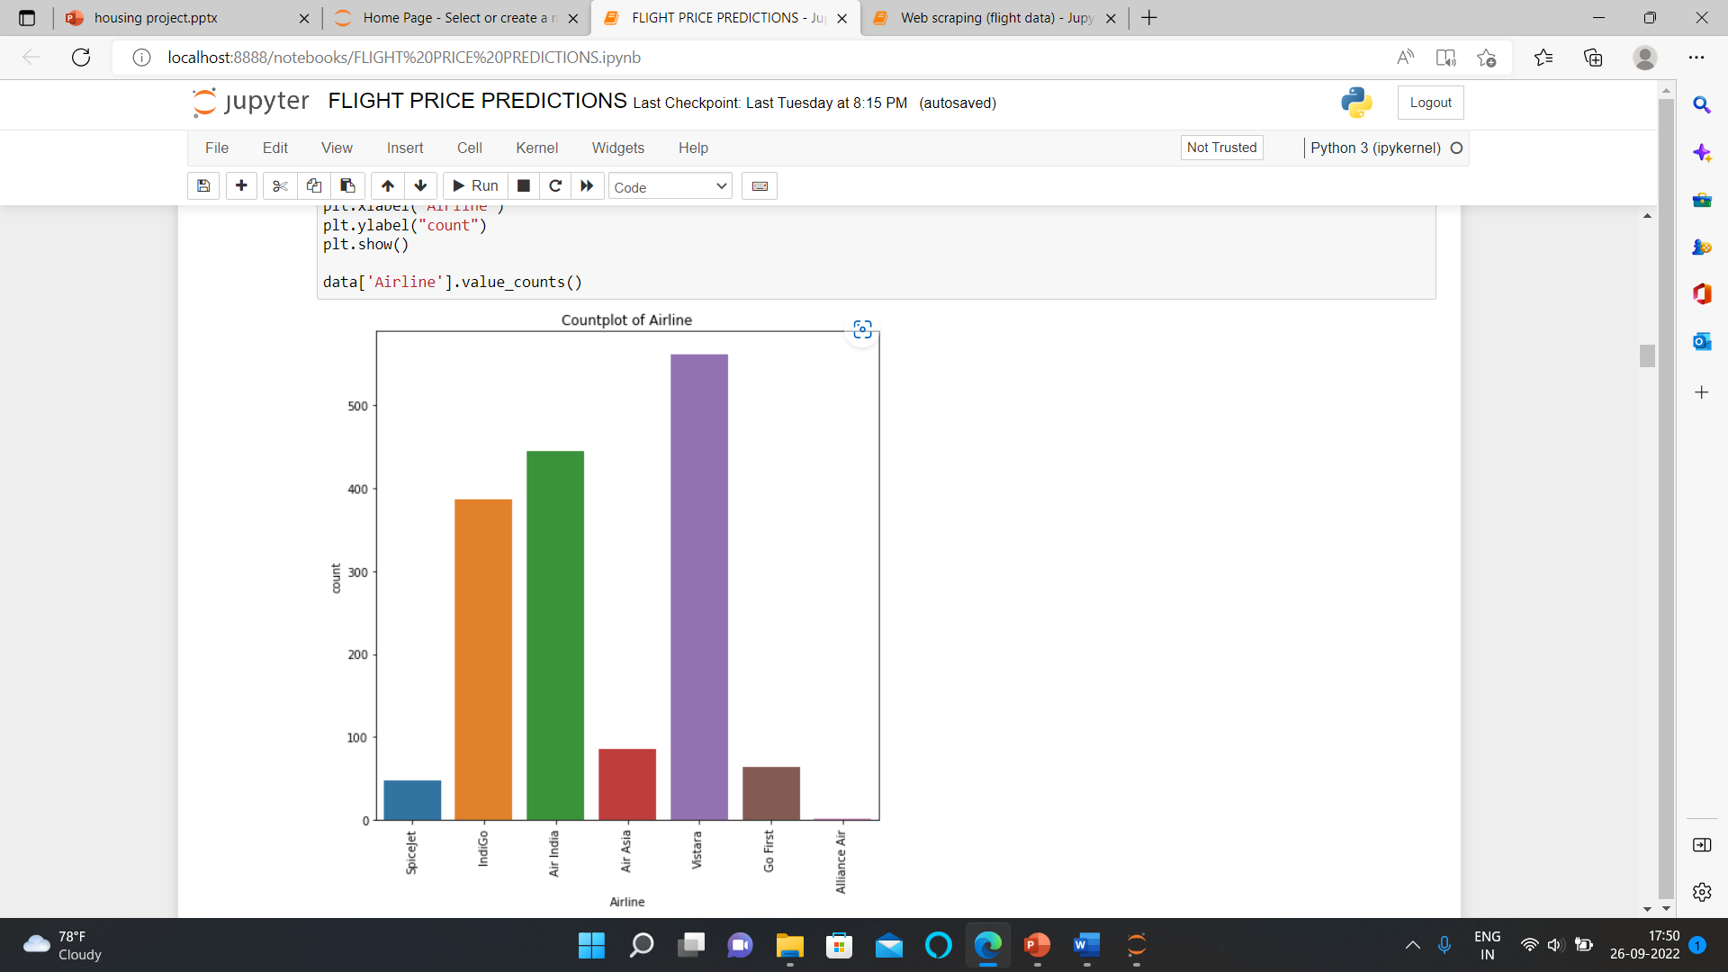
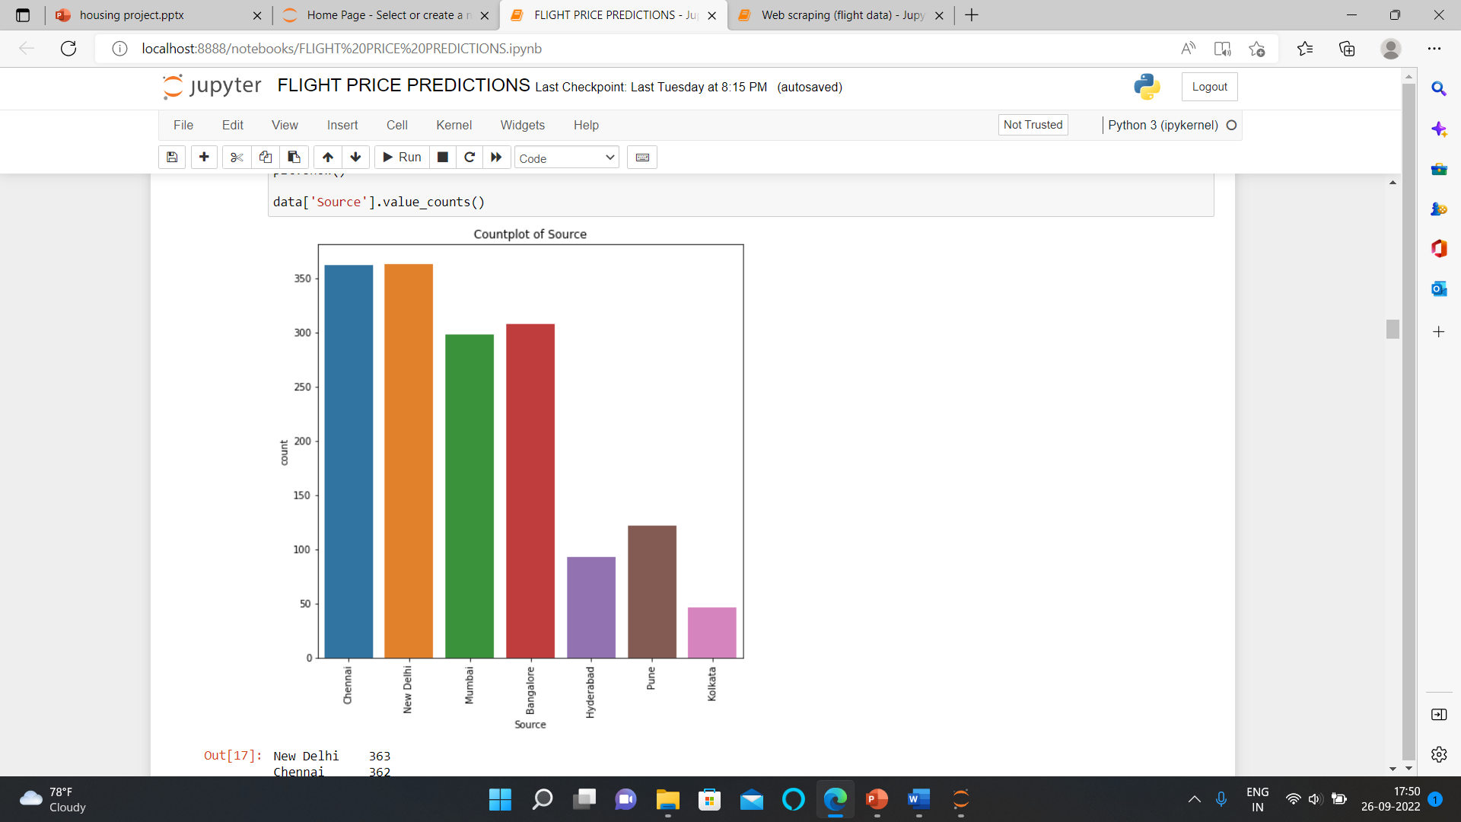
EXPLORATORY DATA ANALYSIS

Slide 6
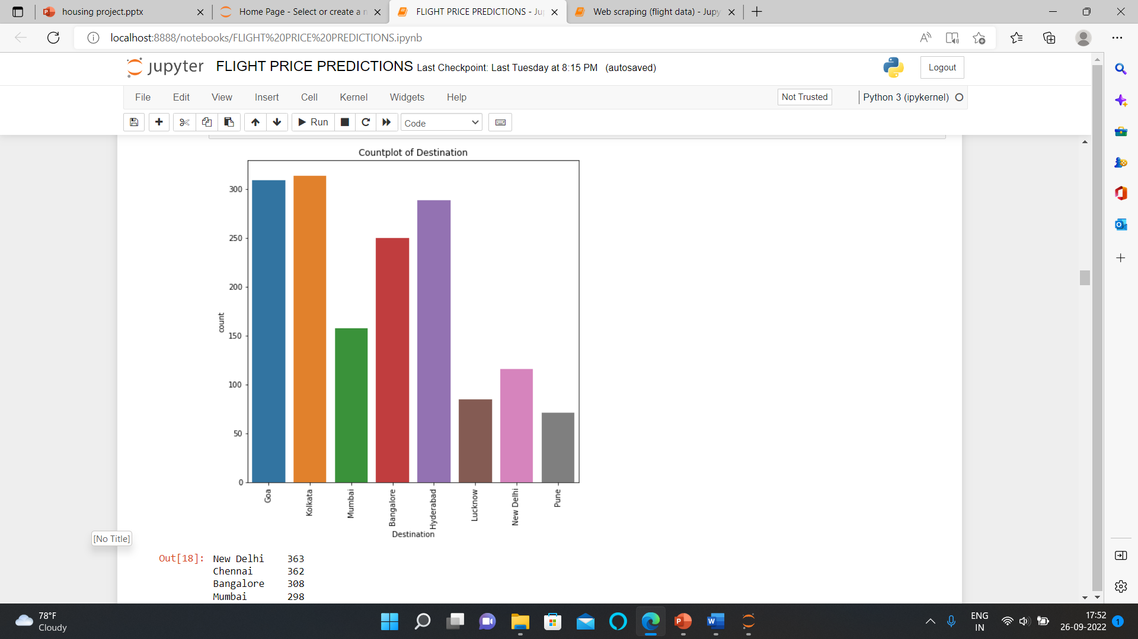
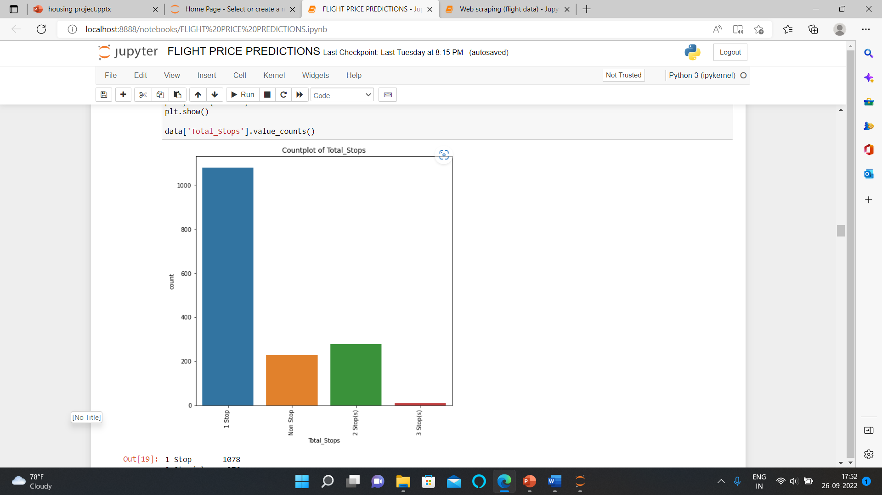

Slide 7
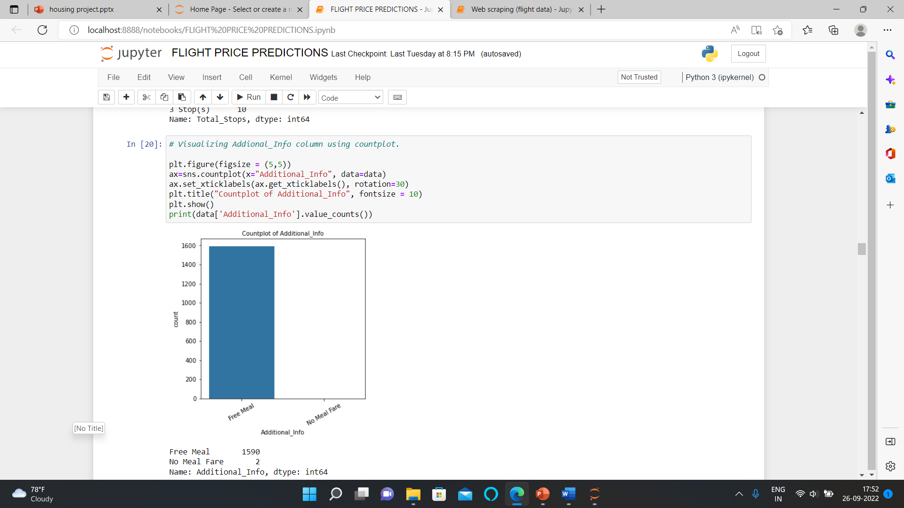

Slide 8
OBSERVATIONS OF UNIVARIATE ANALYSIS
1.Most of the Airline that flies belongs to Vistara and very less are of Alliance air.
2.Most of the flights took off from New Delhi and Chennai and very less from Kolkata.
3.Most of the flights reached to Goa and Kolkata and very less to Pune.
4.Most of the flights only take 1 stop and very less 3 stops.

Slide 9
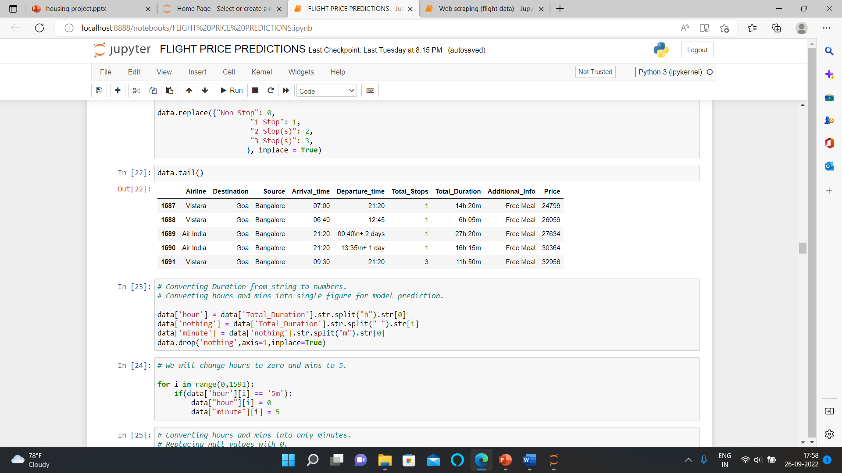
FEATURE ENGINEERING

Slide 10
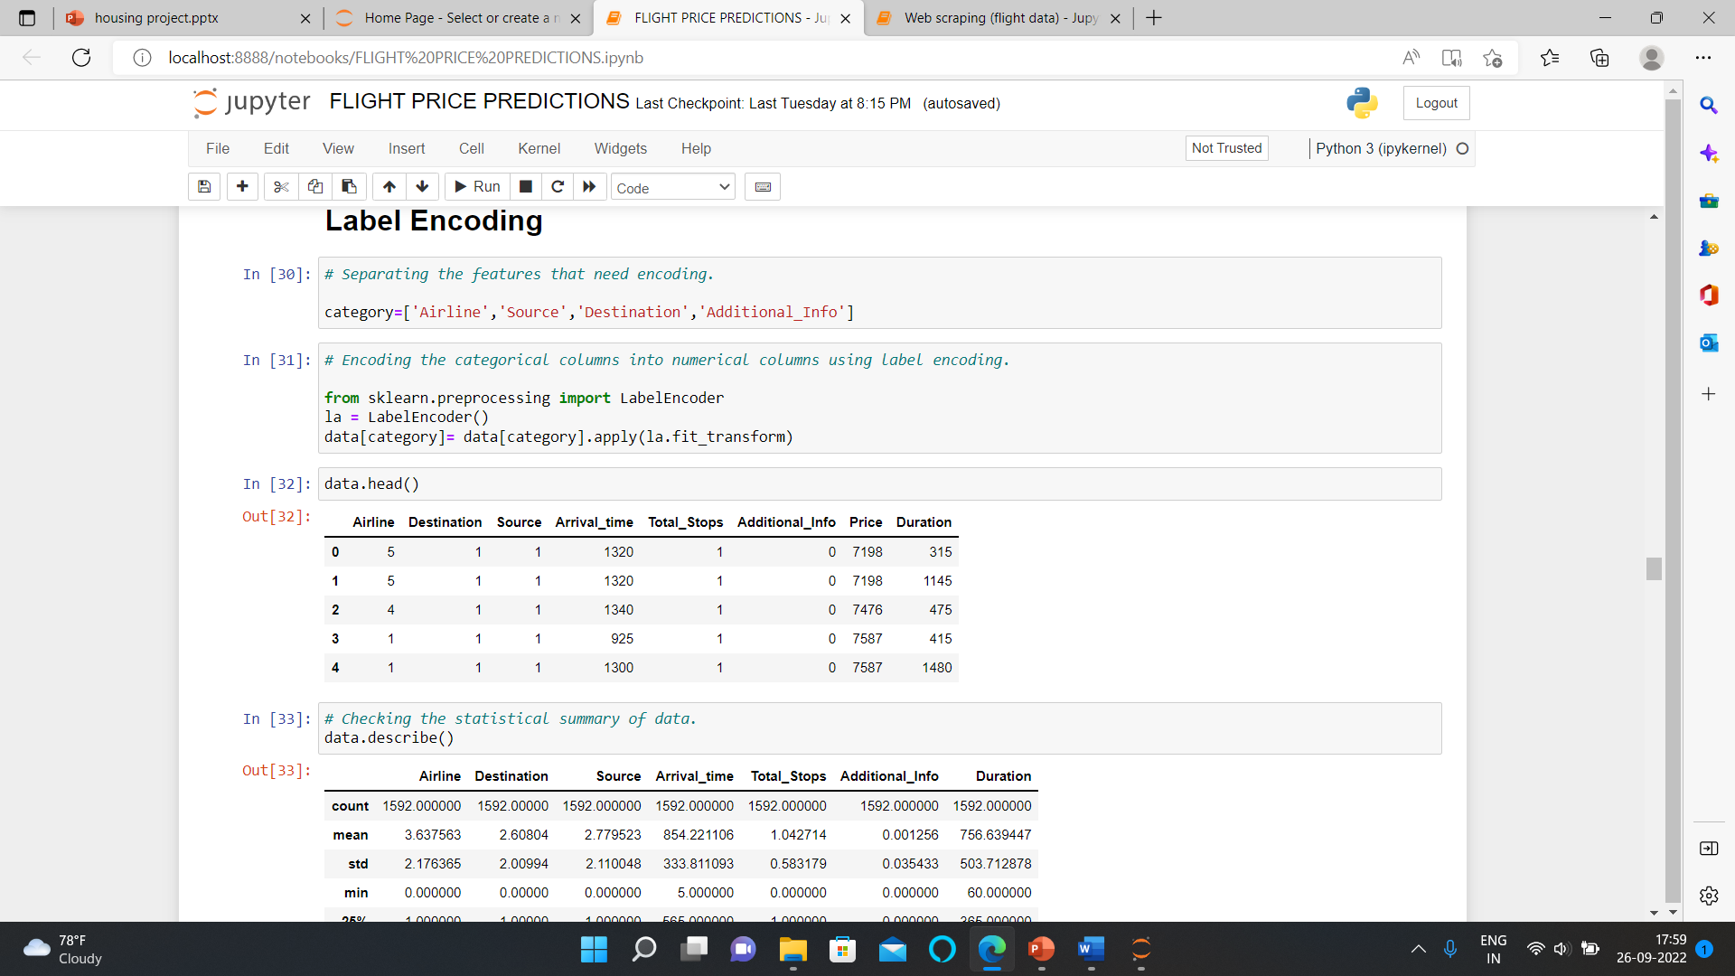
DATA ENCODING

Slide 11
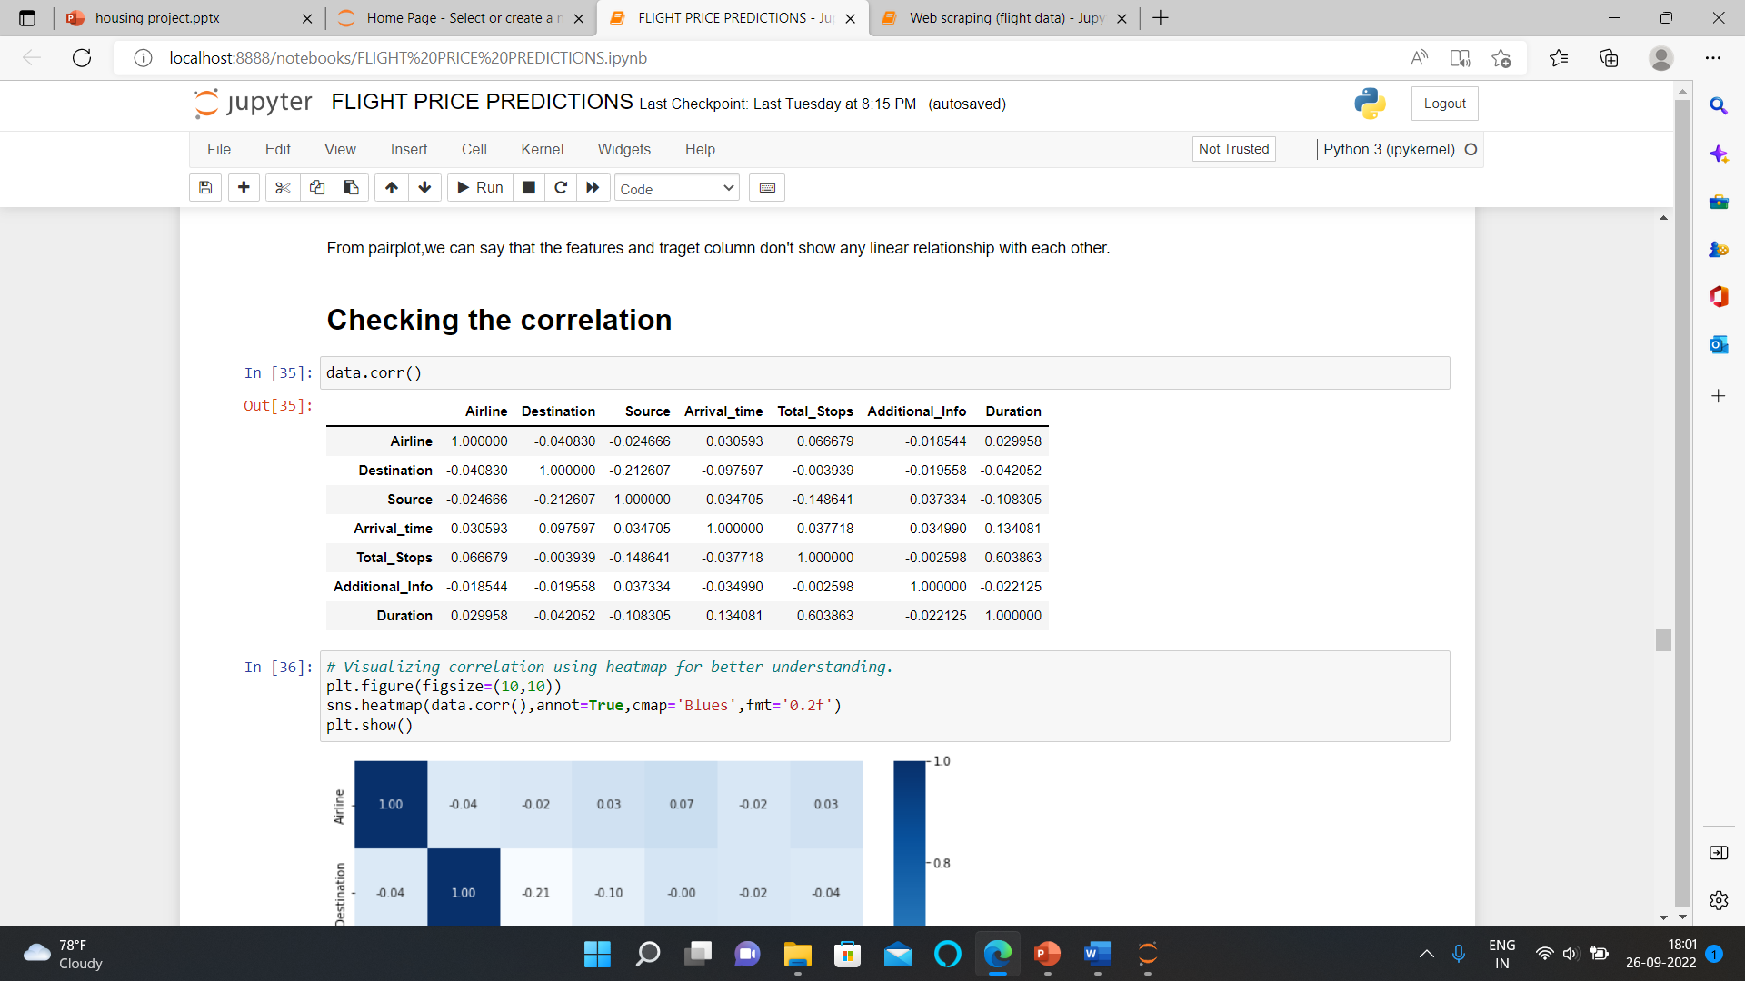
CORRELATION CHECKED

Slide 12
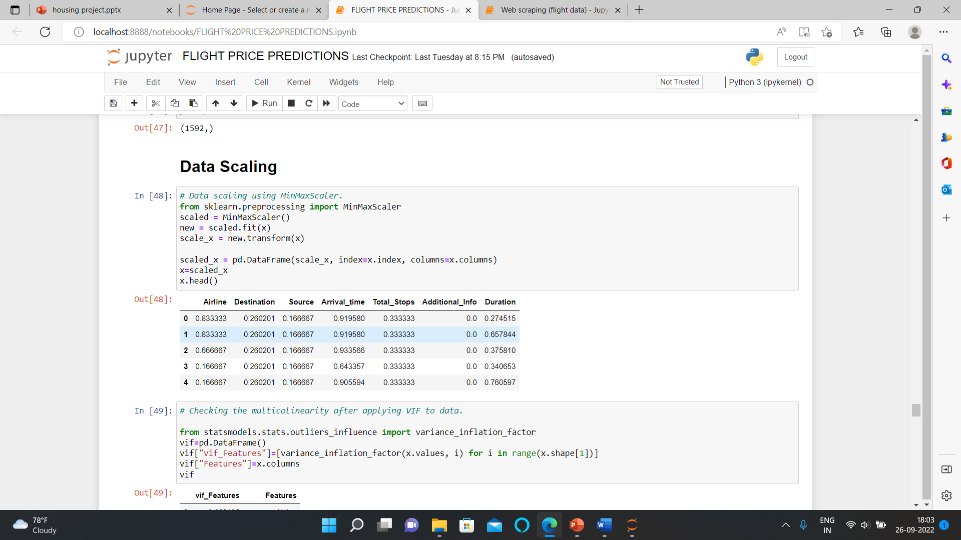
DATA SCALING

Slide 13
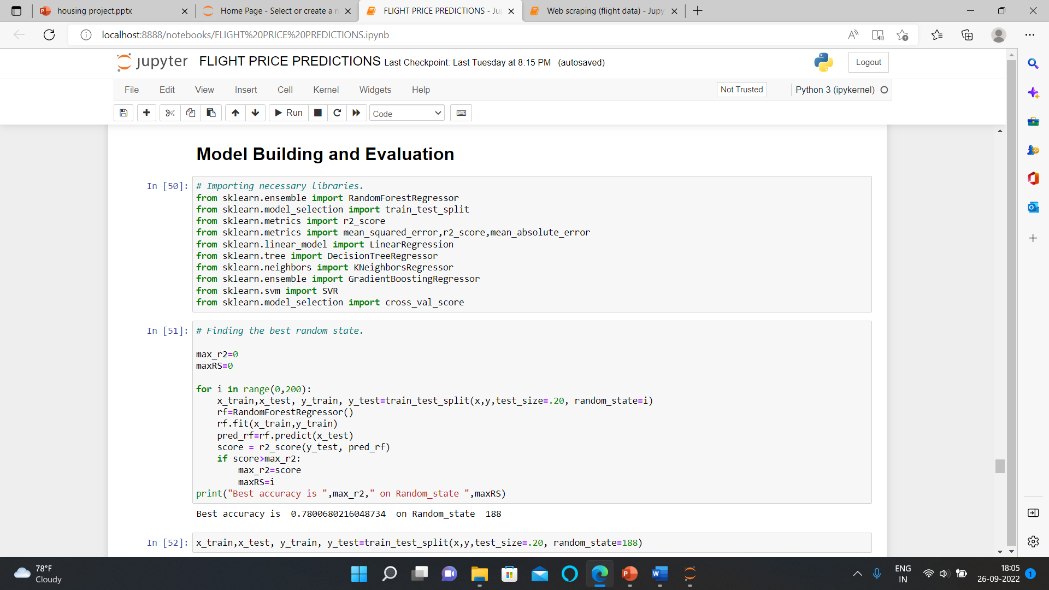
MODEL BUILDING AND EVALUATION

Slide 14
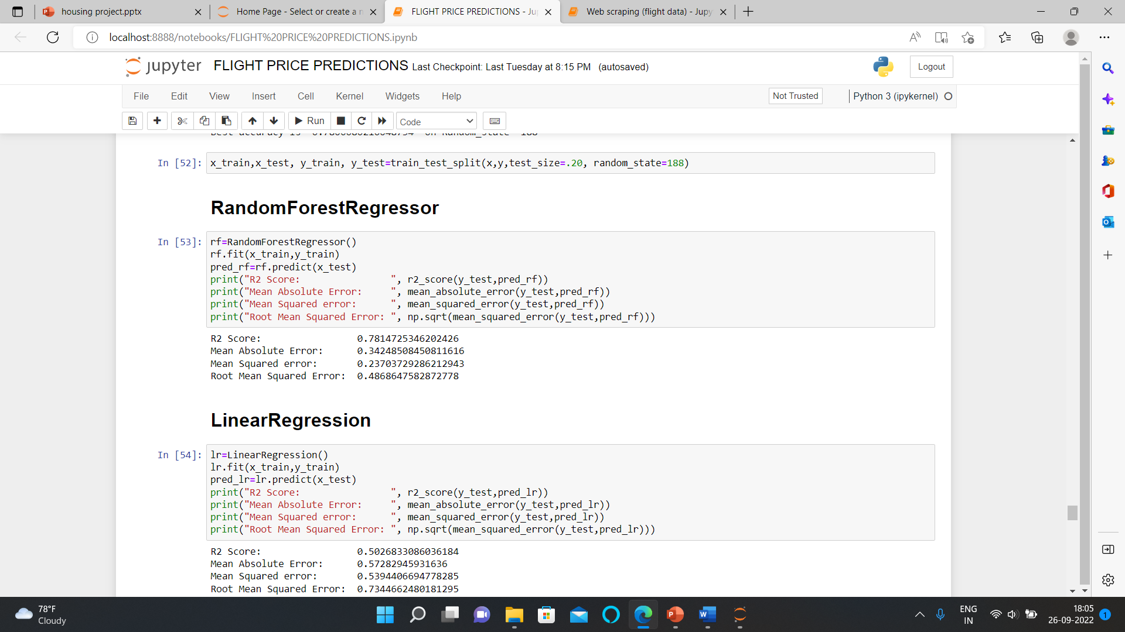

Slide 15
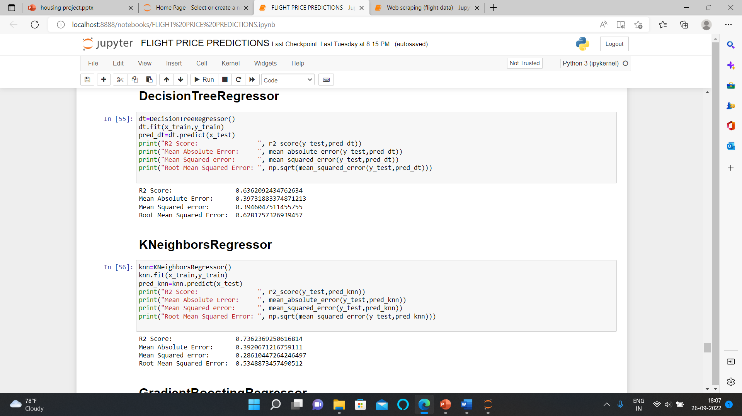

Slide 16
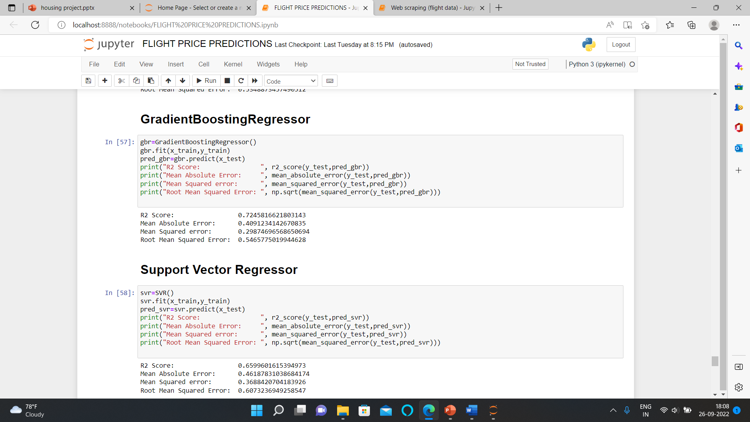

Slide 17
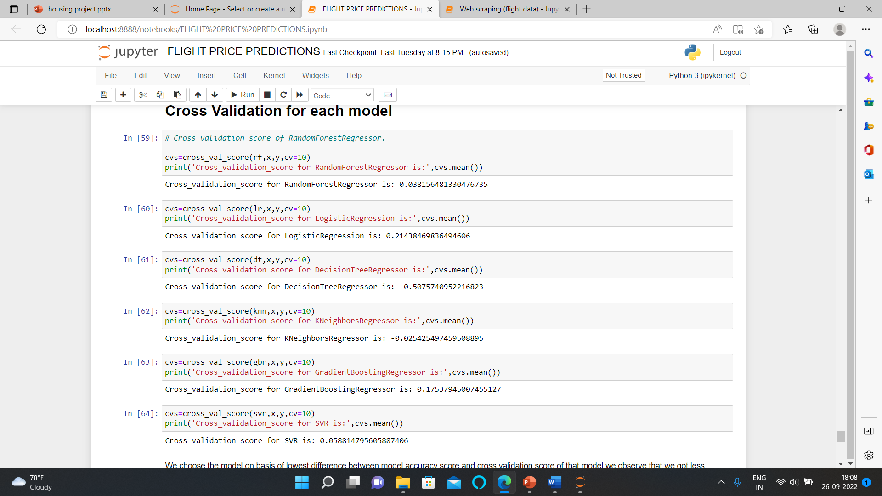
CROSS VALIDATION

Slide 18
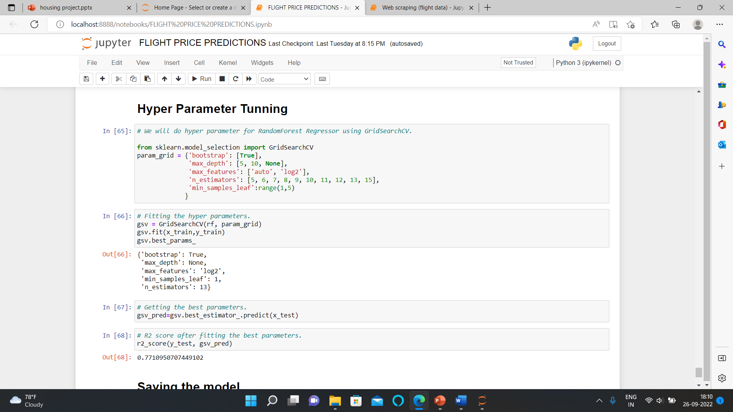
HYPER PARAMETER TUNNING

Slide 19
INTERPRETATION OF RESULTS
The Jet Airway Airlines are more costly than others whereas SpiceJet and IndiGo are quite affordable. Flights from metro cities are more in number and hence few are in budget and few are way too expensive. The expensive flights usually come with layover(long/short), free meal and some other additional facilities as well.
The trend of flight prices vary over various months and across the holiday. There are two groups of airlines: the economic group and the luxurious group. SpiceJet, AirAsia, IndiGo, Go Air are in the economical class, whereas Jet Airways and Air India in the other. Vistara has a more spread out trend.

Slide 20
THANK YOU

